Slide 1
Sessions 3 and 4

Slide 2
Protocol
Communication between two people or two devices needs to follow some protocol
A protocol is a set of rules that governs communication
For example, in a face-to-face communication between two persons, there is a set of implicit rules in each culture that define how two persons should start the communication, how to continue the communication, and how to end the communication

Slide 3
Network Software
Network software uses a protocol stack
A protocol stack contains many layers or levels
Each layer provides some services to the layer above it
Each layer hides complexity of its work from the layer above it
Creates a protocol hierarchy

Slide 4
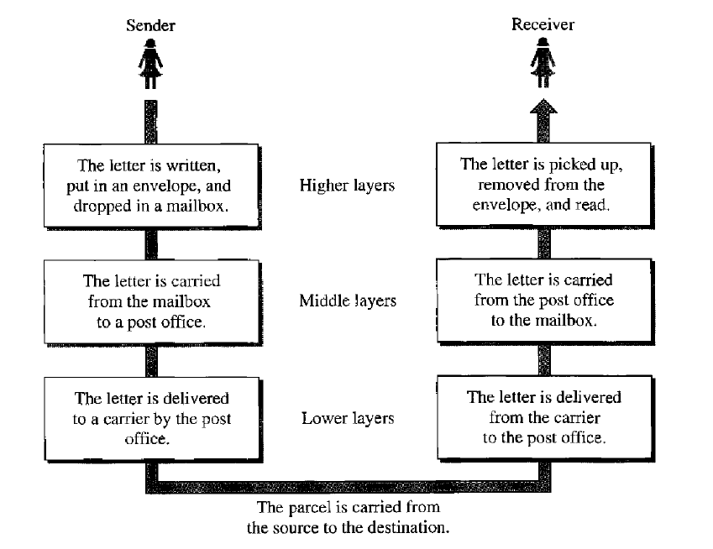
Protocol Hierarchy Example

Slide 5
OSI
Open Systems Interconnection
Good in theory, not used in practice
Contains 7 layers
Sometimes also called ISO/OSI

Slide 6
Layers in OSI
Application Layer
Presentation Layer
Session Layer
Transport Layer
Network Layer
Data Link Layer
Physical Layer
Notes:
6

Slide 7
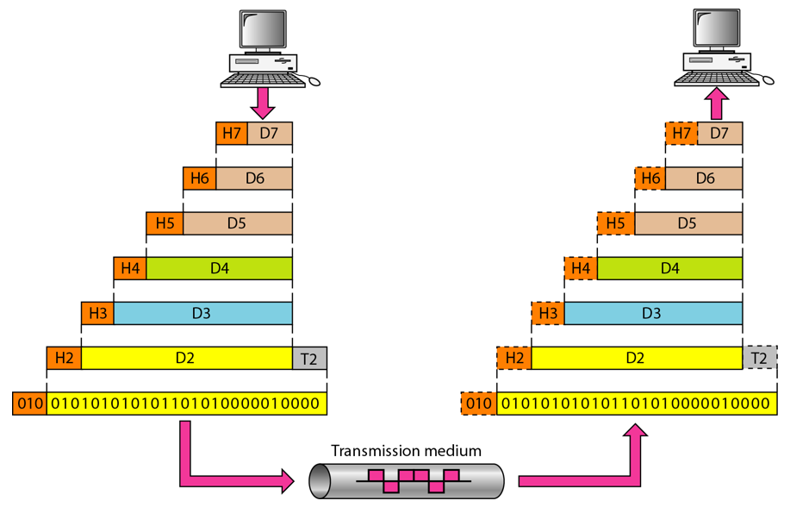
An Exchange using the OSI Model

Slide 8
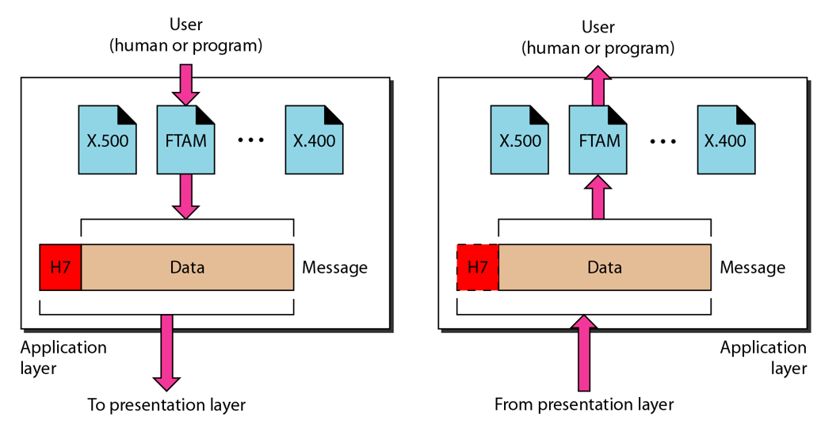
The Application Layer

Slide 9
Application Layer
Provides an “application view” to a network (e.g. email, file transmission)
Example: Hypertext Transfer Protocol (HTTP) is used to access Web pages
Encapsulation begins here
Other examples: Email (SMTP), File transfers (FTP), Querying domain names (DNS)

Slide 10
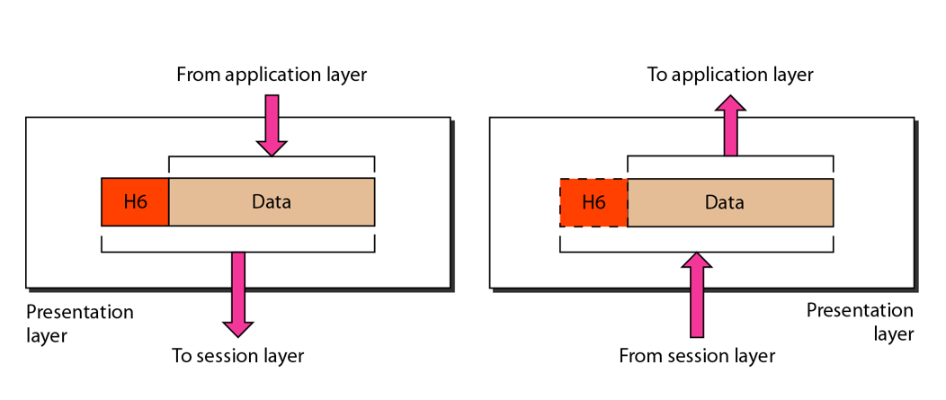
The Presentation Layer

Slide 11
Presentation Layer
Translation: Use of a common format to take care of differences (encoding, number representation etc)
Encryption: To achieve confidentiality or privacy
Compression: Reduces the number of bits needed to be transmitted

Slide 12
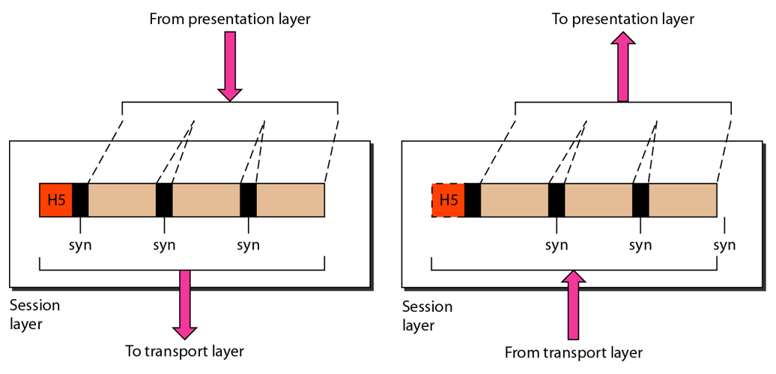
The Session Layer

Slide 13
Session Layer
Manages the session between applications
Example: Between browser of the source computer and server of the destination computer

Slide 14
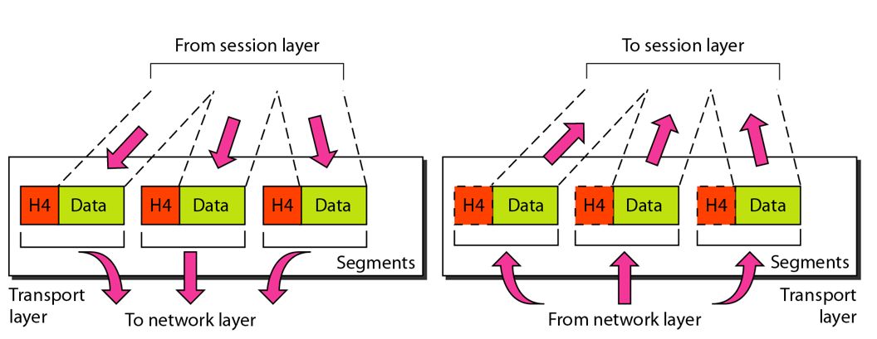
The Transport Layer

Slide 15
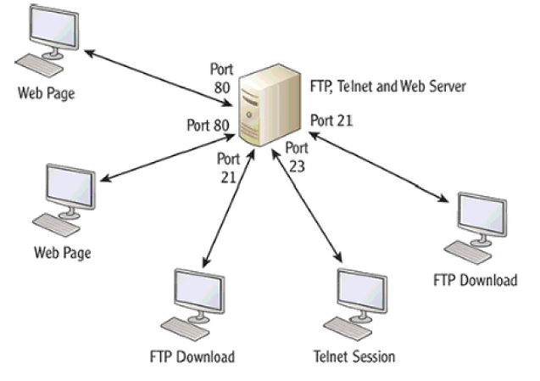
Transport Layer
Identifies the application on the destination computer using port numbers
Example: One server, multiple applications

Slide 16
Port Numbers
Port number is a 16-bit value, so it can store a number between 0 and 65,535
Port Number Range | Where used? | Called as
0-1023 | Server | Well-known ports
1024-49151 | Client | Temporary/Ephemeral
49152-65535 | NA | Dynamic, Usage-based

Slide 17
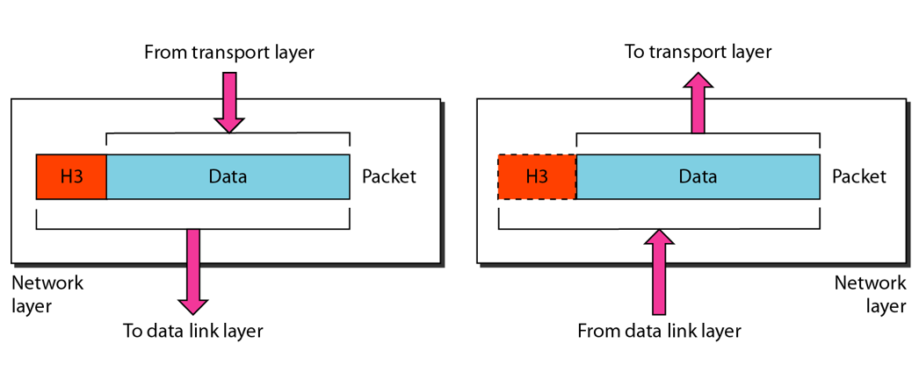
The Network Layer

Slide 18
Network Layer
Physical/MAC addresses are defined by data link layer to take care of addressing inside the same network
If a packet has to travel across a network to another network, physical addressing will not work
Hence, a universal address or a logical address is required. This is done at the network layer
This is the IP address

Slide 19
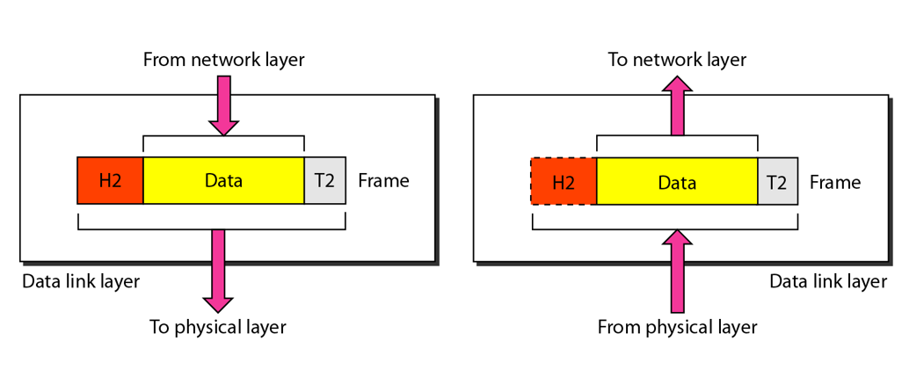
The Data Link Layer

Slide 20
Data Link Layer
Responsible for delivery of packets between two hosts connected to the same physical network (hop-to-hop – see next slide)
Cannot work across networks
Uses frames
Physical addressing: Adding sender’s and receiver’s physical addresses (also called MAC addresses) to the frame header
LAN/WAN operates at this layer (e.g. Ethernet or WiFi)
What if we know the IP address of a computer but do not know its MAC address?
Use Address Resolution Protocol (ARP)

Slide 21
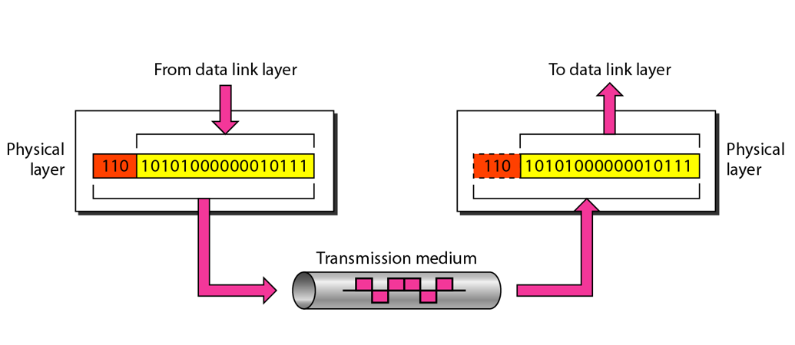
The Physical Layer

Slide 22
Physical Layer Functions
Carries the data (0s and 1s) in the form of signals
Signals can be electric, optical, or wireless

Slide 23
Physical and Logical Address
Each computer on the Internet has two addresses:
Physical address/MAC address/Hardware address
Fixed address, hardcoded on the Network Interface Card (NIC)
Different for different network type (e.g. Ethernet card, WiFi card)
Useful within or inside a network only
Logical address/IP address/Virtual address
Exists in software
Given by the network provider or your organization (usually temporary)
Useful outside a network (e.g. to reach another computer on the Internet, anywhere in the world)

Slide 24
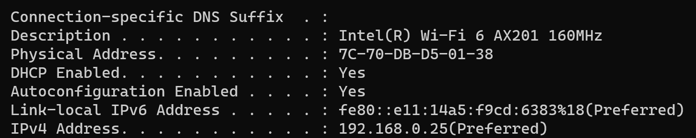
Example

Slide 25
Example
Suppose we have used our web browser to access a web page located on our company’s web server
Consider that the following are the details of the two computers
Computer | IP Address | MAC Address | Port Number
Web server | 192.168.5.1 | 5-5-5-5-5-5 | TCP 80
Laptop | 192.168.5.2 | 6-6-6-6-6-6 | TCP 5091

Slide 26
How will the Web Server Respond?
Layer 7 obtains the data in the form of the HTML document.
Layer 6 adds information about the formatting.
Layer 5 adds information required to create a session between the web server and the web browser on the laptop.
Layer 4 adds the transport protocol and the source and destination port numbers, in this case TCP (it's a unicast) and port 80 (HTTP).
Layer 3 adds the source and destination IP addresses, in this case a source of 192.168.5.1 and a destination of 192.168.5.2.
Layer 2 learns the destination MAC address and adds the source and destination MAC addresses, in this case, a source of 5-5-5-5-5-5 and destination of 6-6-6-6-6-6.
Layer 1 converts the entire package into bits and sends it across the network to the laptop.

Slide 27
How will the Laptop Handle this?
Layer 1 receives the bits in electrical format, converts them to be read by layer 2, and hands them to layer 2.
Layer 2 examines the destination MAC address to see whether it is addressed to it, sees the MAC address of 6-6-6-6-6 (its own), drops that part of the transmission, and hands the remaining data to layer 3.
Layer 3 examines the destination IP address to ensure that it is its own (192. 168.5.2), drops that part, and hands the rest of the package to layer 4.
Layer 4 examines the destination port number (port 5091), alerts the browser that HTTP data is coming in, drops that part, and hands the rest of the package to layer 5.
Layer 5 uses the information that was placed on this layer by the web server to create the session between the web server and the web browser and then hands the rest of the information to layer 6.
Layer 6 performs any format translation that may be required and hands the remaining data (the HTML document) to layer 7.
The layer 7 application (the web browser) receives the HTML document and opens the document in the browser window.

Slide 28
TCP/IP

Slide 29
Basics of TCP/IP
The TCP/IP protocol suite was developed prior to the OSI model
Therefore, the layers in the TCP/IP protocol suite do not match exactly with those in the OSI model
The original TCP/IP protocol suite was defined as four software layers built upon the hardware
Sometimes TCP/IP is thought of as a five-layer model with the layers named similarly to the ones in the OSI model

Slide 30
OSI versus TCP/IP
When we compare the two models, we find that two layers, session and presentation, are missing from the TCP/IP protocol suite
These two layers were not added to the TCP/IP protocol suite after the publication of the OSI model
The application layer in the suite is usually considered to be the combination of three layers in the OSI model
See diagram on the next slide

Slide 31
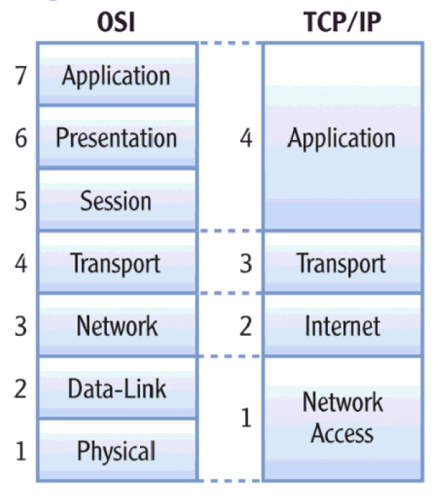
OSI versus TCP/IP

Slide 32
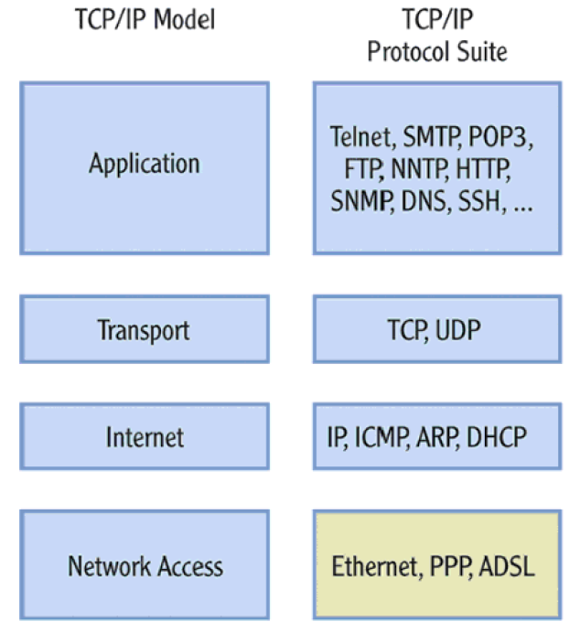
Protocols within Each TCP/IP Layer

Slide 33
Transport Layer Protocols
Transmission Control Protocol (TCP)
Reliable protocol
Guaranteed delivery
Uses connections, acknowledgements
Used for text-based data
User Datagram Protocol (UDP)
Unreliable protocol
No guarantee of delivery
No connections, no acknowledgements
Useful for audio, video or wherever we need speed but not guarantee

Slide 34
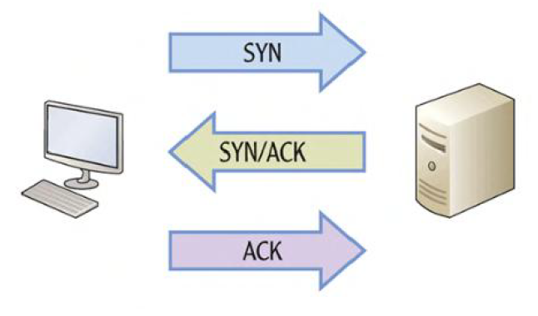
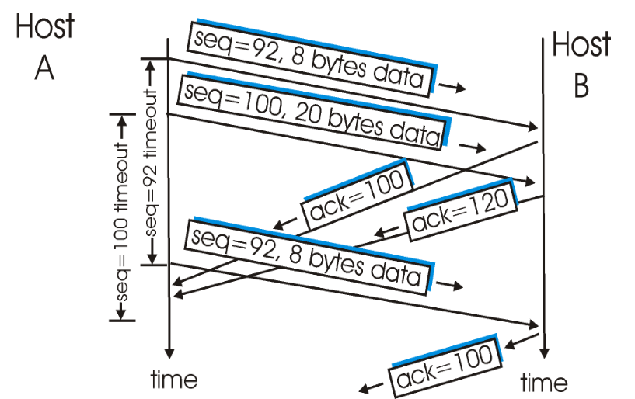
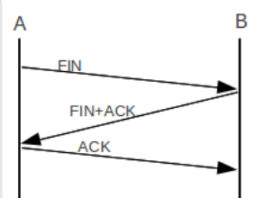
TCP – Connection Management
Connection establishment
Data transfer
Connection termination

Slide 35
UDP
No connection
No acknowledgement
No retransmissions in the case of errors

Slide 36
Internet Layer
Provides logical addressing (IP addresses)
Performs routing
Provides an IP datagram format (See next slide)

Slide 37
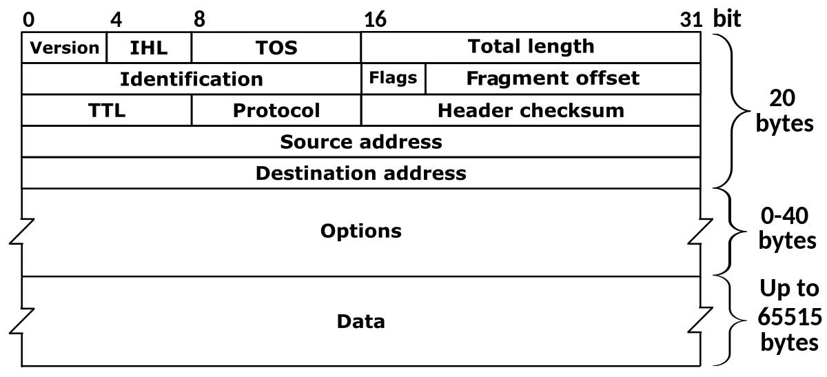
IP Datagram Format

Slide 38
Session 8-10: Network Devices – Hub, Switch, and Router

Slide 39
Networking devices
Inside a network
Hub: Older device
Switch: Modern device
To connect different networks
Router

Slide 40
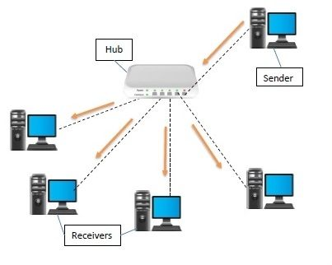
Hub
Earlier, hubs were used as connection devices in Ethernet
Hub is a dumb device, works only at the physical layer (Layer 1)
So, it does not know about MAC addresses, and hence floods out all the ports
All devices that use the same physical media and listen to each frame are considered to be in the same collision domain

Slide 41
Switch
Hubs are obsolete
Switch is an intelligent device – can filter traffic
Example
If a hub connects two branches of a network, it will flood both the branches for every received frame
A switch will check whether it should send it to the other branch of the network by comparing addresses, as discussed shortly

Slide 42
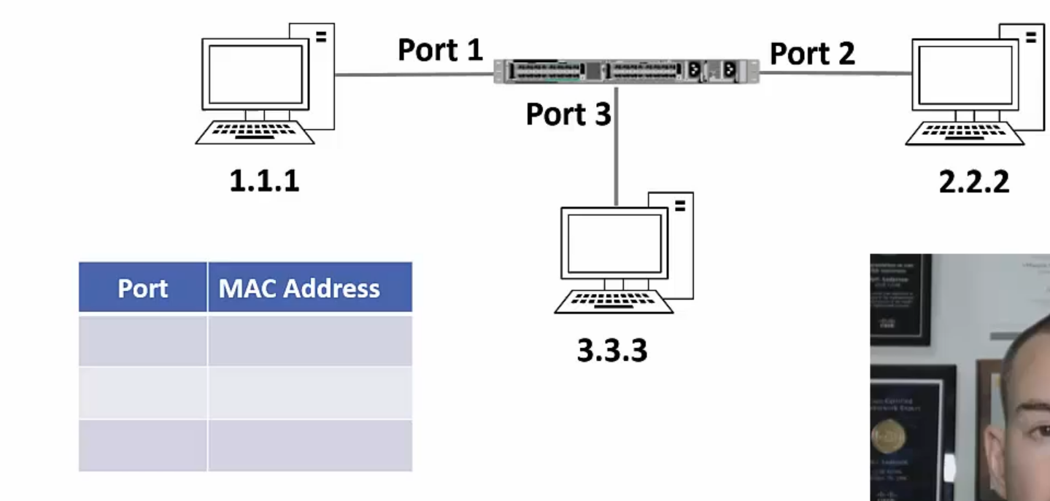
Switching Example – 1
Each switch maintains a mapping table

Slide 43
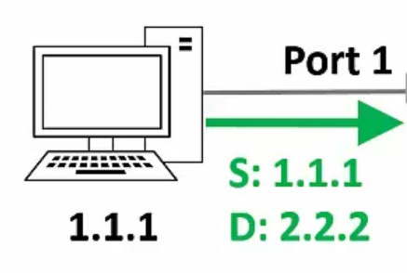
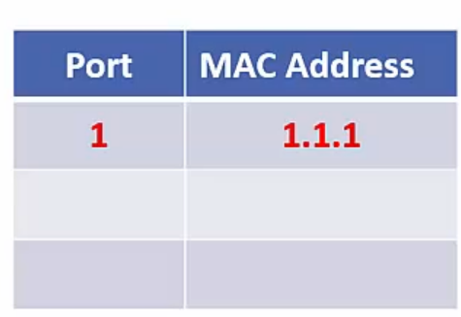
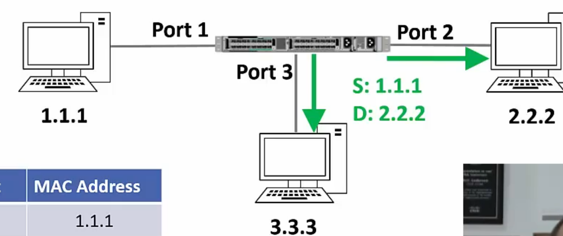
Switching Example – 2
Host 1.1.1 sends a frame to host 2.2.2
Switch sees the frame and updates its mapping table
The switch does not know where 2.2.2 is, so it floods out the frame
`

Slide 44
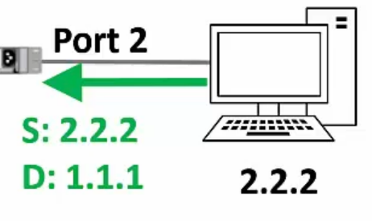
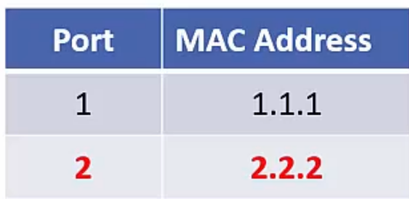
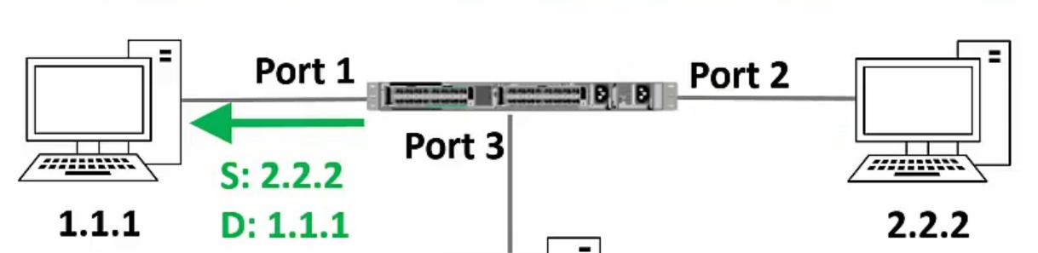
Switching Example – 3
Suppose host 2.2.2 sends a reply to 1.1.1
Switch sees the frame and updates its mapping table
The switch will send the frame only to 1.1.1

Slide 45
Router
A router works at layer 3 (network layer) and uses IP addresses to decide where to deliver packets
Remember: A switch works at layer 2 (data link layer) and uses MAC addresses to decide where to deliver packets
Device | Layer | Uses
Router | 3 (Network) | IP addresses
Switch | 2 (Data link) | MAC addresses

Slide 46
Routing
Routing means taking a packet from one device and sending it through the network to another device on a different network
Switching means taking a packet from one device and sending it through the network to another device on the same network
A switch can be used for sending traffic inside a network
For sending traffic outside a network we need a router

Slide 47
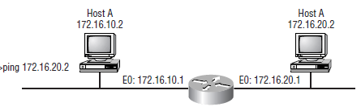
Routing Example
B
Host A and B are on different networks
On a command prompt, the user types ping 172.16.20.2
A packet is generated on the Host A machine using the Internet Protocol (IP)
Host A sends this packet to the router
The router opens the packet and understands that the destination host B is not on the same network
Router forwards the packet to host B
Note: Several additional steps are needed for this, which are not described here for simplicity

Slide 48
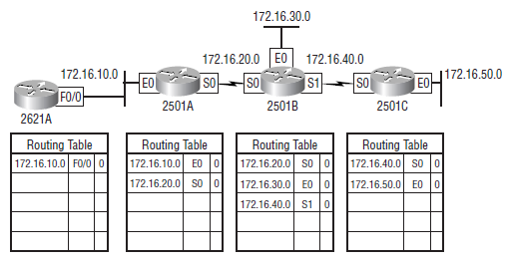
Routing Table
To perform routing, a router needs to build a routing table – Initial state

Slide 49
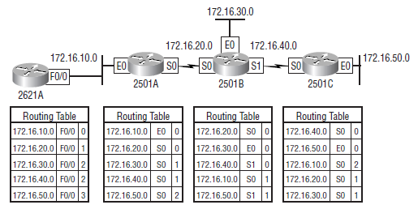
Routing Table after it is Updated
Called as converged routing table

Slide 50
Hubs versus Switches versus Routers
Hub | Switch | Router
Operates at layer 1 (Physical layer) | Operates at layer 2 (Data link layer) | Operates at layer 3 (Network layer)
Works inside a LAN | Works inside a LAN | Works across networks
Generally works only for Ethernet | Generally works only for Ethernet | Supports Ethernet, ISDN, ADSL, etc
Has many ports | Has more ports | Has less ports
A dumb device – floods out all the ports; so does not know about MAC or IP addresses | Works with MAC addresses | Woks with IP addresses

Slide 51

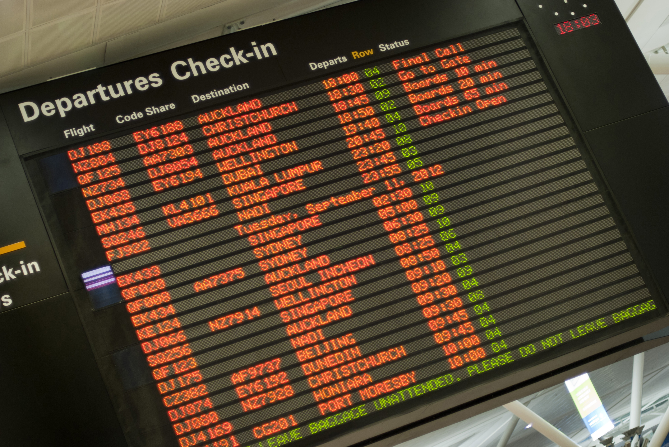
Understanding Routing
Consider a passenger traveling from Pune to Sioux Falls, USA
Pune
Mumbai
San Francisco
Chicago
Sioux Falls
Hop Number | From | To | Passenger’s View
1 | Pune | Mumbai | Pune-Sioux Falls
2 | Mumbai | San Francisco | Pune-Sioux Falls
3 | San Francisco | Chicago | Pune-Sioux Falls
4 | Chicago | Sioux Falls | Pune-Sioux Falls

Slide 52

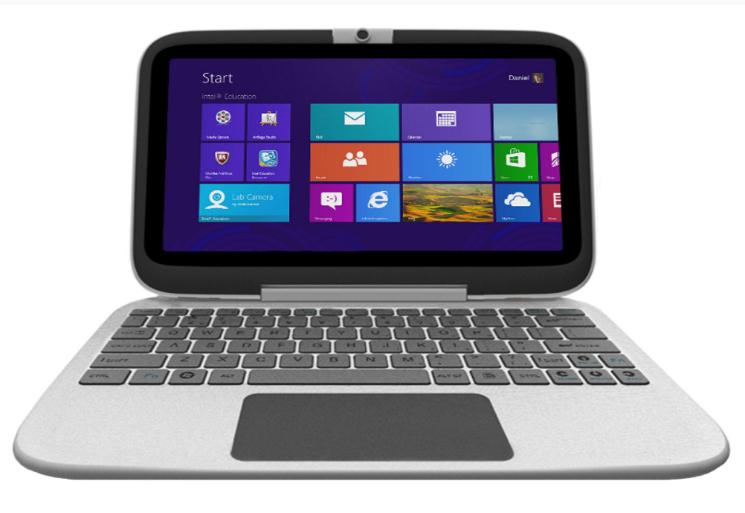

Understanding Routing
Consider a datagram/packet going from computer A to computer B
A
R1
R2
R3
B
 | Data Link Layer | View
Hop Number | From | To | IP View
1 | A | R1 | A-B
2 | R1 | R2 | A-B
3 | R2 | R3 | A-B
4 | R3 | B | A-B

Slide 53
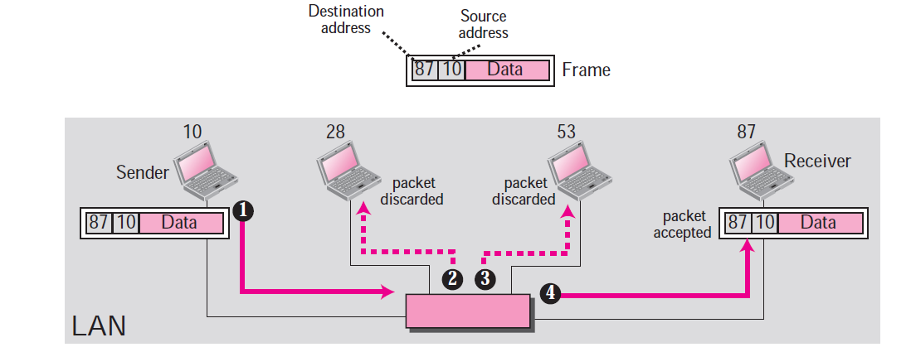
MAC Addresses and LAN

Slide 54
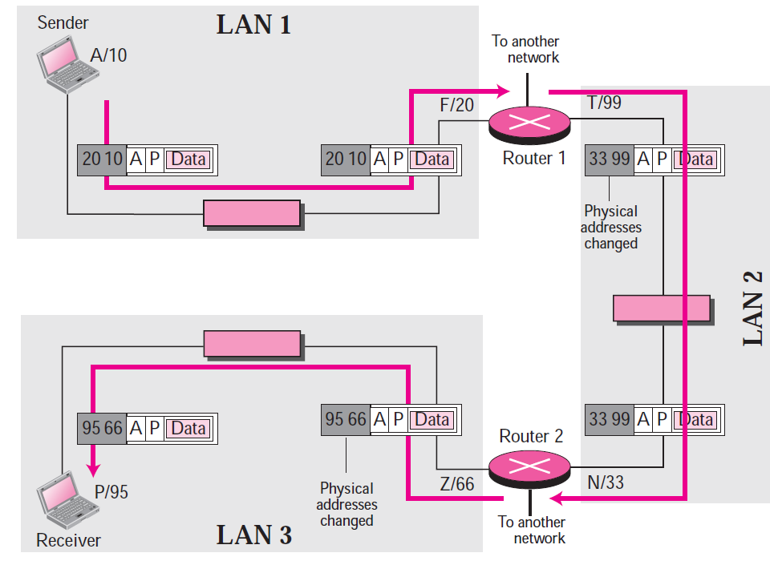
IP Addresses and the Internet

Slide 55
Address Resolution Protocol (ARP)
Takes IP address of a computer as input and finds the MAC address of that computer
Useful to deliver the data to a particular MAC address

Slide 56
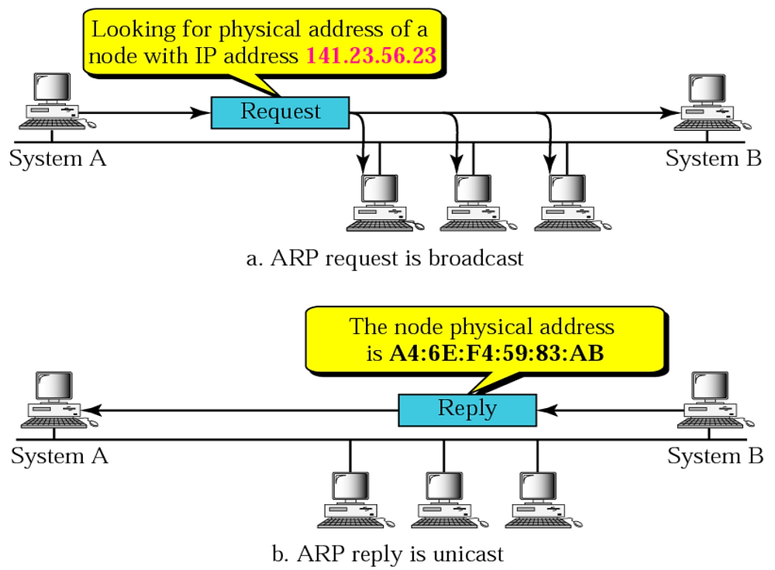
ARP Example

Slide 57
Internet Message Control Protocol (ICMP)
IP is
Connectionless
Unreliable
Unacknowledged
Datagrams are sent over the Internet with no prior connection, no assurance of delivery, and no acknowledgement if they reach the destination successfully
What happens if a router must discard a datagram because it cannot find a router to the final destination, or because the time-to-live field has a zero value?
What happens if the final destination host must discard all fragments of a datagram because it has not received all fragments within a predetermined time limit?
The Internet Control Message Protocol (ICMP) helps IP

Slide 58
ICMP Message Types
Error-reporting messages
Report problems that a router or a host (destination) may encounter when it processes an IP packet
Query messages
Occur in pairs, help a host or a network manager get specific information from a router or another host.
For example, nodes can discover their neighbors.
Also, hosts can discover and learn about routers on their network and routers can help a node redirect its messages.

Slide 59
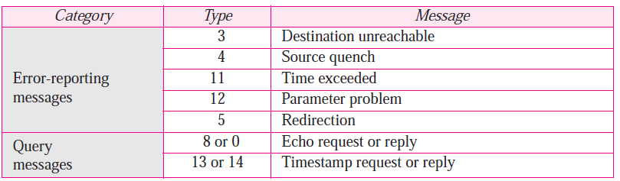
ICMP Messages
Notes:
59

Slide 60
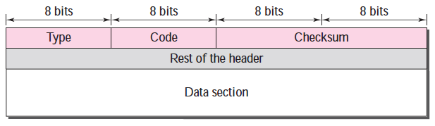
ICMP Message Format
Has a 8-byte header and variable-size data section
General format of the header is different for each message type, the first 4 bytes are common to all
Defines the type of the message
Specifies the reason for the specific message type
Carries information for finding the original packet that had error

Slide 61
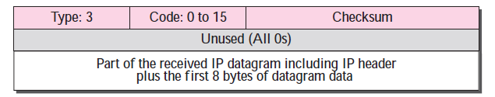
Example: Destination Unreachable
When a router cannot route an IP datagram, it sends this message
Notes:
61

Slide 62
Destination Unreachable – Sample ‘Code’ field Values
Code 0: Network is unreachable
Code 1: Host is unreachable
Code 2: Protocol is unreachable (e.g. TCP is not running on the destination)
Code 3: Port is not reachable
Code 4: Fragmentation is needed, but “Do not fragment” field is set
Code 6: Destination network is unknown
Code 7: Destination host does not exist
Notes:
62

Slide 63
Dynamic Host Configuration Protocol (DHCP)
Need for DHCP
Computers have permanent MAC addresses, but generally dynamic IP addresses
Static IP addresses need to be manually configured by the administrator
Example: People using their own devices, mobile phones needing Internet connectivity, Accessing the Internet at home and in the office
DHCP concept
An organization or the network service provider sets up a DHCP server
A device needing an IP address contacts the server, and asks for an IP address
The server allocates an IP address to the computer for a specific duration

Slide 64
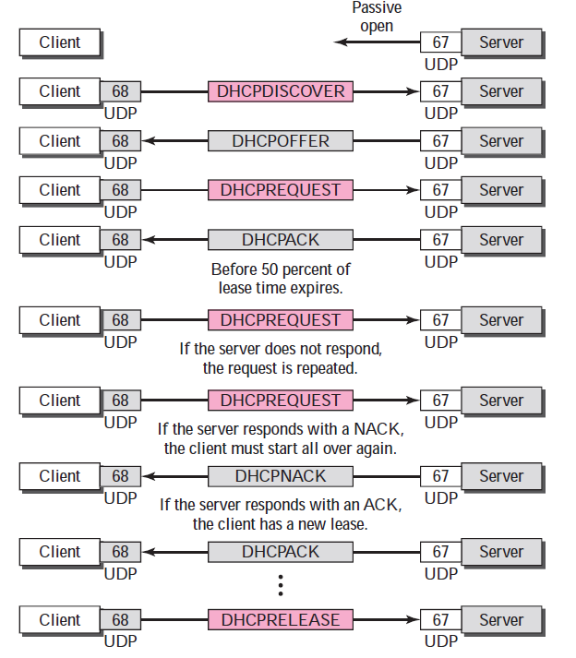
DHCP Flow

Slide 65
The 169 Address
IP address of 169.x.x.x indicates a problem with obtaining a valid IP address from a DHCP server
The 169.254.x.x range, specifically, is reserved for Automatic Private IP Addressing (APIPA)
When a device is unable to obtain an IP address from a DHCP server, it may assign itself an address in this range to allow it to communicate on the local network without a configured IP address.
If we have a device with a 169.x.x.x IP address on our network, it usually indicates a network configuration issue, such as a DHCP server problem or network connectivity issues

Slide 66
Sessions 6 and 7: IP Addressing and Routing

Slide 67
IP Address
An IP address has two parts:
Network Id: Identifies which network it belongs to
Host Id: On a given network, what is the host number
Examples:
This notation is called as dotted decimal notation
Some portion of the network id is reserved to indicate class of IP address
Hence, this is called as classful addressing
14.22.130.89
143.1.99.204
193.56. 78.21

Slide 68
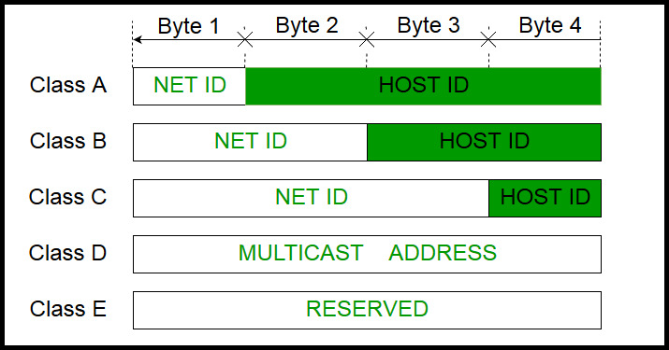
IP Address Classes

Slide 69
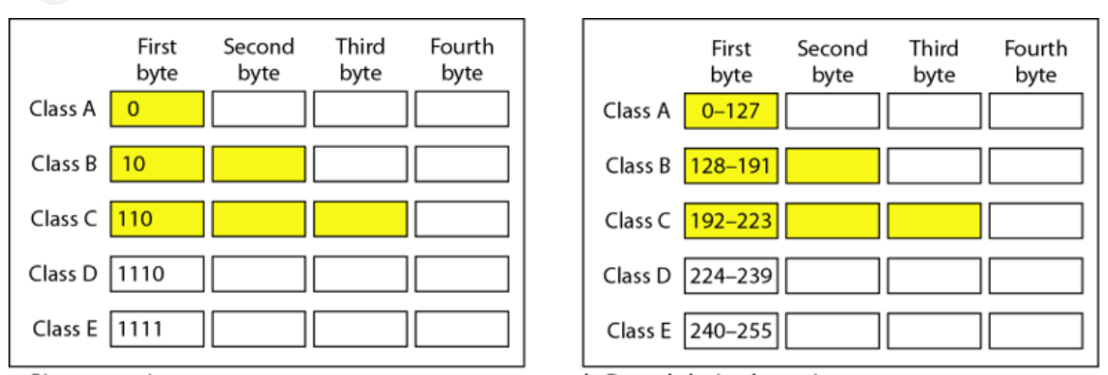
Classful Addressing

Slide 70
Classes – How to Determine/Remember? – Three Techniques
Look at the first few bits of the binary value of the network id
First bit 0: Class A
First two bits 10: class B
First three bits 110: class C
Look at the first decimal octet/byte value of the network id
0-127: Class A
128-191: Class B
192-223: Class C
Use the flow-chart on the following slide

Slide 71
Determining Class
First bit = 0?
Yes
Class A address
No
Second bit = 0?
Yes
Class B address
No
Third bit = 0?
Yes
Class C address
No
Fourth bit = 0?
Yes
Class D address
No
Class E address
Notes:
71

Slide 72
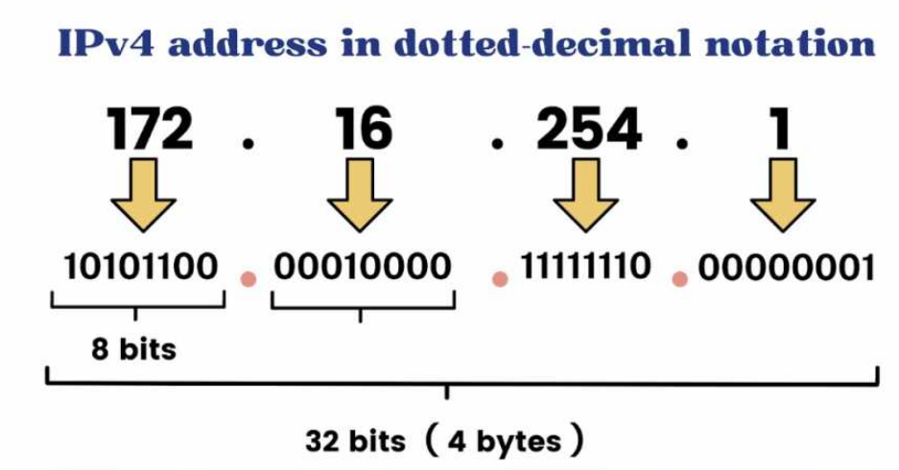
Dotted Decimal Notation

Slide 73
Masking
Hide the host id part of an IP address
Retain the network id part
This is called masking (the host id part)

Slide 74
Calculation
The address whose network ID we want
134.45.78.2
Default mask for class B (since the address above is from class B)
AND
255.255.0.0
Network ID for the address
134.45.0.0

Slide 75
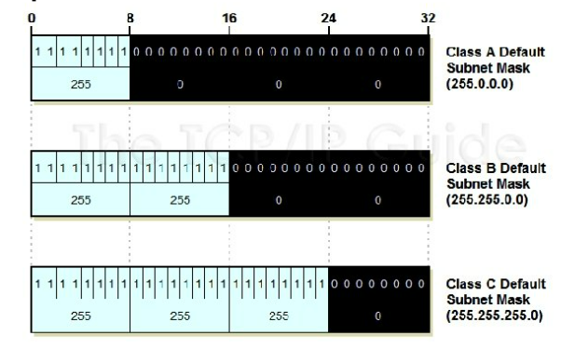
Default Mask

Slide 76
Default Masks
Class | Mask in Binary | Mask in dotted-decimal
A | 11111111 00000000 00000000 00000000 | 255.0.0.0
B | 11111111 11111111 00000000 00000000 | 255.255.0.0
C | 11111111 11111111 11111111 00000000 | 255.255.255.0
Notes:
76

Slide 77
Masking Examples
Given an IP address of 23.56.7.91, find the network address.
Given an IP address of 132.6.17.85, find the network address.
Notes:
77

Slide 78
Private/Local/Internal IP Addresses
The following ranges of IP addresses are reserved as private/local/internal IP addresses, and they cannot be assigned to a computer on the Internet as a public/external IP address
Class A: 10.0.0.0 to 10.255.255.255
Class B: 172.16.0.0 to 172.31.255.255
Class C: 192.168.0.0 to 192.168.255.255

Slide 79
Subnetting
Notes:
79

Slide 80
Before Subnetting
Consider student PRN number made up of two parts: Course code and enrolment number within the course (shown in binary)
PRN 0000000000 = First student in HPCSA
PRN 0000000001 = Second student in HPCSA
PRN 0000000010 = Third student in HPCSA
…
PRN 0010000000 = First student in HPCAP
PRN 0010000001 = Second student in HPCAP
PRN 0010000010 = Third student in HPCAP
…
PRN 0100000000 = First student in DITISS
PRN 0100000001 = Second student in DITISS
PRN 0100000010 = Third student in DITISS
…
Course code
000 = HPCSA
001 = HPCAP
010 = DITISS
011 = DAC
…
Enrolment number
0000000 = Student 1
0000001 = Student 2
0000010 = Student 3
0000011 = Student 4
…

Slide 81
After Subnetting
PRN 0000000000 = First student in HPCSA Batch 1
PRN 0000000001 = Second student in HPCSA Batch 1
PRN 0000000010 = Third student in HPCSA Batch 1
…
PRN 0000010000 = First student in HPCSA Batch 2
PRN 0000010001 = Second student in HPCSA Batch 2
PRN 0000010010 = Third student in HPCSA Batch 2
…
PRN 0000100000 = First student in HPCSA Batch 3
PRN 0000100001 = Second student in HPCSA Batch 3
PRN 0000100010 = Third student in HPCSA Batch 3
…
PRN 0010000000 = First student in HPCAP Batch 1
PRN 0010000001 = Second student in HPCAP Batch 1
PRN 0010000010 = Third student in HPCAP Batch 1
...
PRN 0010010000 = First student in HPCAP Batch 2
PRN 0010010001 = Second student in HPCAP Batch 2
PRN 0010010010 = Third student in HPCAP Batch 2
…
We need to create up to four
batches for each course
Course code
000 = HPCSA
001 = HPCAP
010 = DITISS
011 = DAC
…
Enrolment number
0000 = Student 1
0001 = Student 2
0010 = Student 3
0011 = Student 4
…
Batch number
000 = First batch
001 = Second batch
010 = Third batch
011 = Fourth batch

Slide 82
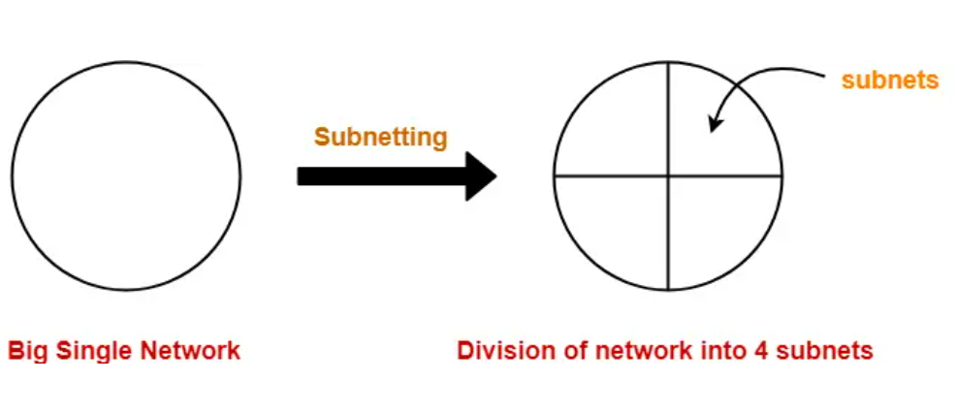
Subnetting Concept

Slide 83
Subnet Concept
Network id
Host id
Two ways to address a particular house
Building number, House number (Normal IP address)
Building number, Floor number, House number (IP address with subnet)
Subnet id
Network id
Host id
Notes:
83

Slide 84
Subnetting
Divide a network into smaller sub-networks with each subnet having its own IP address
Allow a network to be split into several internal sub-networks, but act like a single network to the outside world
Motivation: Make better use of the IP address space
IP addresses: Two levels of hierarchy; subnetting makes it three
Notes:
84

Slide 85
Subnet Mask
If host A and host B are on the same subnet, communication through them can happen through a switch
If host A and B are not on the same subnet, traffic between them must go through a router
So, if A wants to send packets to B, A must first know if B is on the same subnet or not
For this, it compares its IP address with --B’s IP address
The subnet mask is used for this
It is also 32-bit long, and written using dotted-decimal notation or slash notation

Slide 86
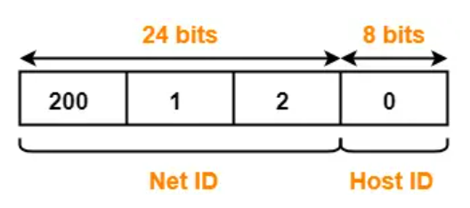
Subnetting Example
Consider a network having IP address 200.1.2.0
We want to divide this into two parts, creating two subnets
Analysis: Network belongs to class C

Slide 87
Subnetting Example
We want to create two subnets
Subnet 1 will have id 0₂
Subnet 2 will have id 1₂
IP address length is always 32 bits
For the current example, we have:
Net id: 24 bits
Host id: 8 bits
We need one bit for the subnet id: From where to take, and why?

Slide 88
Subnetting Example
If we take 1 bit from the net ID
Net id will become 23 bit
What will be the impact?
Current net ID is:
Which bit to take?
Suppose we take the last bit in the third octet (i.e. 0)
Now net ID will become 200.1.1 (because last octet will now be of only 7 bits 0000001)
Suppose we take the first bit in the first octet (i.e. 1)
Now net ID will become 72.1.1 (because first octet will now be of only 7 bits 1001000)
Conclusion: We cannot touch the net ID
200 | 1 | 2
11001000 | 00000001 | 00000010

Slide 89
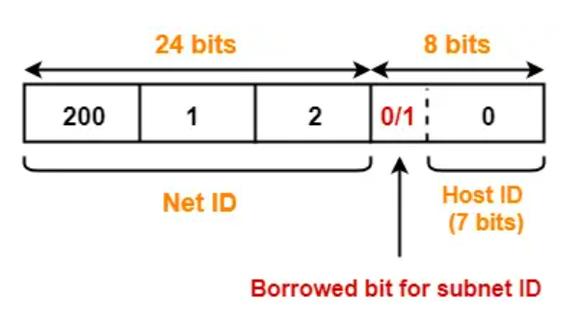
Subnetting Example
Conclusion: We must take one bit from the host id
This bit must be from the leftmost part of the host id
Now, the host id will only have 7 bits
If borrowed bit = 0, then it represents the first subnet
If borrowed bit = 1, then it represents the second subnet

Slide 90
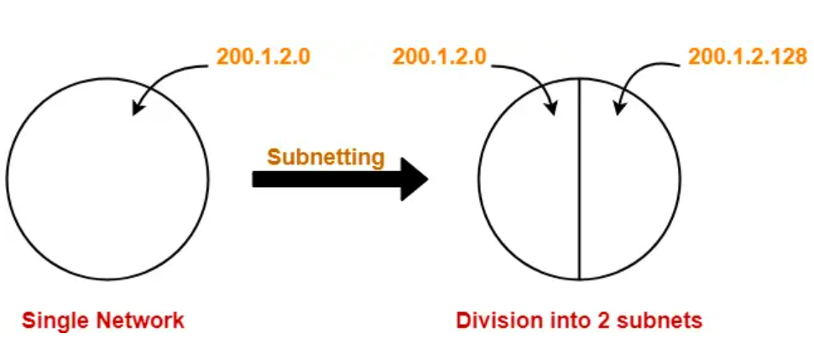
Resulting Subnets
IP addresses of the two subnets:
200.1.2.00000000 = 200.1.2.0
200.1.2.10000000 = 200.1.2.128

Slide 91
Subnet 1
Network address of the subnet = 200.1.2.0
Total number of IP Addresses = 2⁷ = 128
Total number of hosts that can be configured = 128 – 2 = 126
Range of IP Addresses = [200.1.2.00000000, 200.1.2.01111111] = [200.1.2.0, 200.1.2.127]
Broadcast Address = 200.1.2.01111111 = 200.1.2.127

Slide 92
Subnet 2
Network address of the subnet = 200.1.2.128
Total number of IP Addresses = 2⁷ = 128
Total number of hosts that can be configured = 128 – 2 = 126
Range of IP Addresses = [200.1.2.10000000, 200.1.2.11111111] = [200.1.2.128, 200.1.2.255]
Direct Broadcast Address = 200.1.2.11111111 = 200.1.2.255

Slide 93
Easy Technique for Decimal to Binary IP Address Conversion
Always keep the following table in mind:
Example: Convert 236 in decimal to binary
Step 1: Is 236 >= 128? Yes. So, put a 1 in the box below 128 and write the result of 236 - 128 = 108 in brackets:
128 | 64 | 32 | 16 | 8 | 4 | 2 | 1
128 | 64 | 32 | 16 | 8 | 4 | 2 | 1
1 (108)

Slide 94
Easy Technique for Decimal to Binary IP Address Conversion
Step 2: Is 108 >= 64? Yes. So, put a 1 in the box below 64 and write the result of 108 - 64 = 44 in brackets:
Step 3: Is 44 >= 32? Yes. So, put a 1 in the box below 32 and write the result of 44 - 32 = 12 in brackets:
128 | 64 | 32 | 16 | 8 | 4 | 2 | 1
1 (108)
1 (44)
128 | 64 | 32 | 16 | 8 | 4 | 2 | 1
1 (108)
1 (44)
1 (12)

Slide 95
Easy Technique for Decimal to Binary IP Address Conversion
Step 4: Is 12 >= 16? No. So, put a 0 in the box below 16 and write the 12 in brackets:
Step 5: Is 12 >= 8? Yes. So, put a 1 in the box below 8 and write the result of 12 - 8 = 4 in brackets:
128 | 64 | 32 | 16 | 8 | 4 | 2 | 1
1 (108)
1 (44)
1 (12)
0 (12)
128 | 64 | 32 | 16 | 8 | 4 | 2 | 1
1 (108)
1 (44)
1 (12)
0 (12)
1 (4)

Slide 96
Easy Technique for Decimal to Binary IP Address Conversion
Step 6: Is 4 >= 4? Yes. So, put a 1 in the box below 4 and write the 4 - 4 = 0 in brackets:
Since we have already reached 0, fill the remaining two with 0s
128 | 64 | 32 | 16 | 8 | 4 | 2 | 1
1 (108)
1 (44)
1 (12)
0 (12)
1 (4)
1 (0)
128 | 64 | 32 | 16 | 8 | 4 | 2 | 1
1 (108)
1 (44)
1 (12)
0 (12)
1 (4)
1 (0)
0 (0)
0 (0)

Slide 97
Final Answer
236 in decimal = 11101100 in binary

Slide 98
Converting an IP Address to Binary
Consider an IP address 192.168.10.15
Since 192 >= 128, write 1 and calculate 192 - 128 = 64
Since 64 >= 64, write 1 and calculate 64 - 64 = 0
Since we have already reached 0, remaining positions are all 0
128 | 64 | 32 | 16 | 8 | 4 | 2 | 1
1 (64)
128 | 64 | 32 | 16 | 8 | 4 | 2 | 1
1 (64)
1 (0)
128 | 64 | 32 | 16 | 8 | 4 | 2 | 1
1 (64)
1 (0)
0 (0)
0 (0)
0 (0)
0 (0)
0 (0)
0 (0)

Slide 99
Converting an IP Address to Binary
Consider an IP address 192.168.10.15
Since 168 >= 128, write 1 and calculate 168 - 128 = 40
Since 40 NOT >= 64, write 0 and retain 40
Since 40 is >= 32, write 1 and calculate 40 - 32 = 8
128 | 64 | 32 | 16 | 8 | 4 | 2 | 1
1 (40)
128 | 64 | 32 | 16 | 8 | 4 | 2 | 1
1 (64)
0 (40)
128 | 64 | 32 | 16 | 8 | 4 | 2 | 1
1 (64)
0 (40)
1 (8)

Slide 100
Converting an IP Address to Binary
Consider an IP address 192.168.10.15
Since 8 NOT >= 16, write 0 and retain 8
Since 8 >= 8, write 1 and calculate 8 – 8 = 0
Fill remaining ones with 0
128 | 64 | 32 | 16 | 8 | 4 | 2 | 1
1 (64)
0 (40)
1 (8)
0 (8)
128 | 64 | 32 | 16 | 8 | 4 | 2 | 1
1 (64)
0 (40)
1 (8)
0 (8)
1 (0)
128 | 64 | 32 | 16 | 8 | 4 | 2 | 1
1 (64)
0 (40)
1 (8)
0 (0)
1 (0)
0 (0)
0 (0)
0 (0)

Slide 101
Final Answer
Complete the remaining two octets in a similar manner
Final answer: 192.168.10.15 in binary is:
192 | 168 | 10 | 15
11000000 | 10101000 | 00001010 | 00001111

Slide 102
Exercise
Consider that we have a single network having IP Address 200.1.2.0
We want to do subnetting and divide this network into 4 subnets

Slide 103
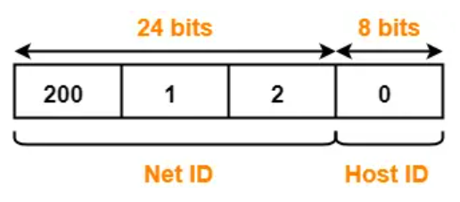
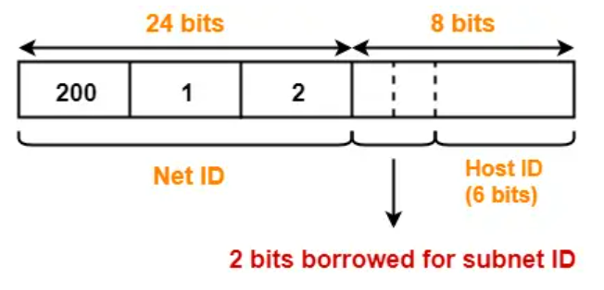
Solution
The network belongs to class C
To create 4 subnets, we need 2 bits from the host id to be used as subnet id
Host id will now have 6 bits
Subnet IDs
Subnet ID 1: 00
Subnet ID 2: 01
Subnet ID 3: 10
Subnet ID 4: 11

Slide 104
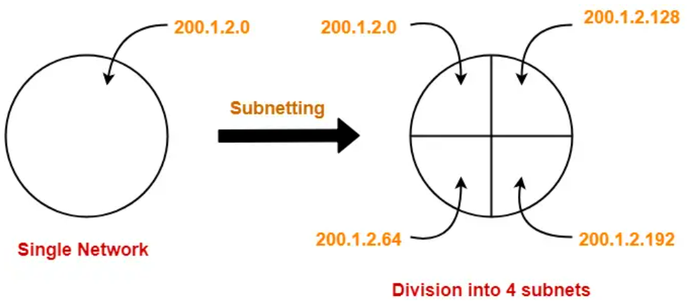
Solution
IP addresses of the four subnets
200.1.2.00000000 = 200.1.2.0
200.1.2.01000000 = 200.1.2.64
200.1.2.10000000 = 200.1.2.128
200.1.2.11000000 = 200.1.2.192

Slide 105
Subnet 1
Network Address of the subnet = 200.1.2.0
Total number of IP Addresses = 2⁶ = 64
Total number of hosts that can be configured = 64 – 2 = 62
Range of IP Addresses = [200.1.2.00000000, 200.1.2.00111111] = [200.1.2.0, 200.1.2.63]
Broadcast Address = 200.1.2.00111111 = 200.1.2.63

Slide 106
Subnet 2
Network Address of the subnet = 200.1.2.64
Total number of IP Addresses = 2⁶ = 64
Total number of hosts that can be configured = 64 – 2 = 62
Range of IP Addresses = [200.1.2.01000000, 200.1.2.01111111] = [200.1.2.64, 200.1.2.127]
Broadcast Address = 200.1.2.01111111 = 200.1.2.127

Slide 107
Subnet 3
Network Address of the subnet = 200.1.2.128
Total number of IP Addresses = 2⁶ = 64
Total number of hosts that can be configured = 64 – 2 = 62
Range of IP Addresses = [200.1.2.10000000, 200.1.2.10111111] = [200.1.2.128, 200.1.2.191]
Broadcast Address = 200.1.2.10111111 = 200.1.2.191

Slide 108
Subnet 4
Network Address of the subnet = 200.1.2.192
Total number of IP Addresses = 2⁶ = 64
Total number of hosts that can be configured = 64 – 2 = 62
Range of IP Addresses = [200.1.2.11000000, 200.1.2.11111111] = [200.1.2.192, 200.1.2.255]
Broadcast Address = 200.1.2.11111111 = 200.1.2.255

